Slide 1
I400 – Application Development in Java
Lecture 3

Slide 2
Today
CH 4 –
Mathematical Methods
Escape Sequences
Characters
String Methods
String Formatting

Slide 3
Math Methods
We’ve already seen Math.pow(), but there’s a lot more in the Math module:
Method | Result | Explanation
Math.sqrt(9) | 3 | Square Root
Math.ceil(7.1) | 8 | Ceiling (Rounds up, always)
Math.floor(4.9) | 4 | Floor (Rounds down, always)
Math.round(5.6) | 6 | Rounding (To closest whole number)
Math.min(1.5, 3.1) | 1.5 | Minimum of two numbers
Math.max(2.7, -1.0) | 2.7 | Maximum of two numbers
Math.abs(-10.3) | 10.3 | Absolute Value

Slide 4
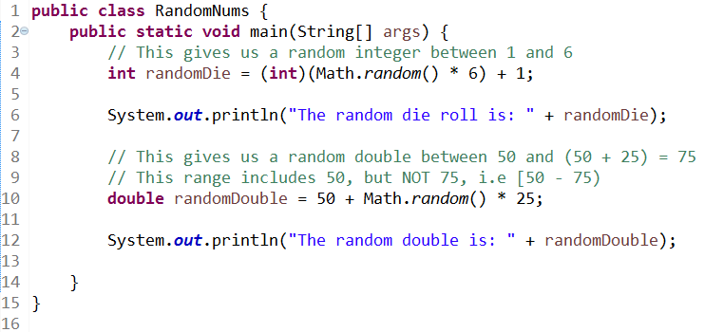


Random Numbers
We can also use the Math module to generate random numbers:

Slide 5


Odds (Group Work)
Write the Odds class. The user is asked to wager on which of two game players wins (gets the largest number) – Player1, who rolls 2 six-sided dice and adds them together, or Player2, who rolls 2 ten-sided dice and takes the larger value between them. For the sake of simplicity, ties always result in a loss.

Slide 6
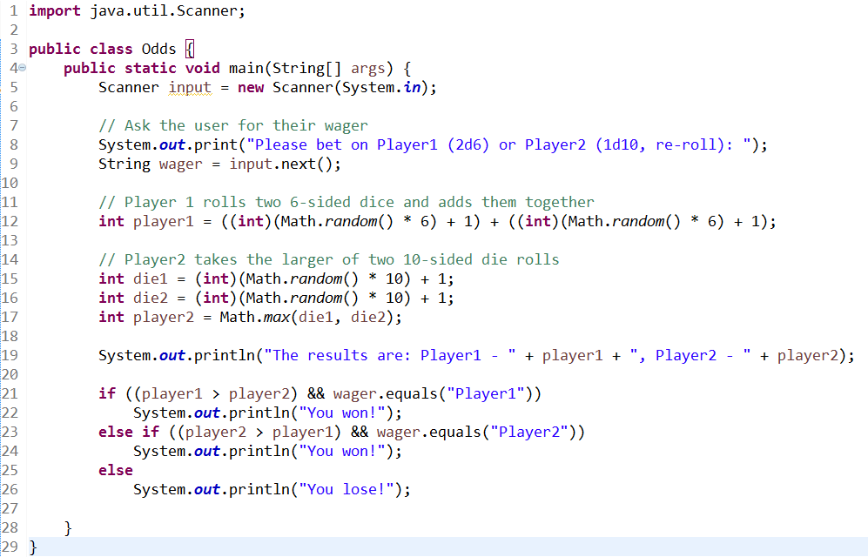
Odds (Solution)

Slide 7
Escape Sequences
Java includes the usual escape sequences. Remember, these must go inside quotes to be used!
Escape Sequence | Result
\t | tab
\n | newline
\\ | Escape a \
\" | Escape a "

Slide 8
Characters
Strings are sequences of characters, which have a different base type in Java: char
Chars are declared with single quotes, whereas Strings use double quotes:
char a = 'A';
String greeting = "Hi!";

Slide 9
Character Methods
Characters support the following useful methods:
Method | Result
Character.isDigit('a') | false
Character.isLetter('a') | true
Character.isLetterOrDigit('a') | true
Characer.isLowerCase('a') | true
Character.isUpperCase('a') | false
Character.toLowerCase('A') | 'a'
Character.toUpperCase('a') | 'A'

Slide 10
String Methods
Strings have some helpful methods as well:
String message = "Hello";
Method | Result
message.length() | 5
message.charAt(0) | 'H' // This uses index numbers!
message.concat("!") | "Hello!"
message.toUpperCase() | "HELLO!"
message.toLowerCase() | "hello!"
message.trim() | // the same as .strip() from Python

Slide 11
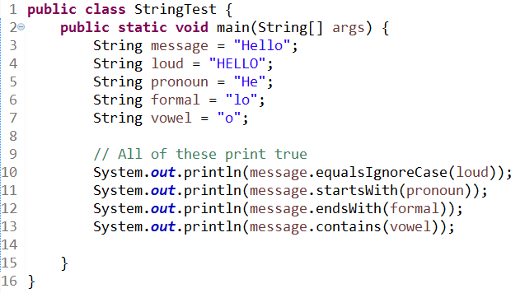
String Comparison Methods
While we already know .equals(), there are some other useful String comparison methods:

Slide 12
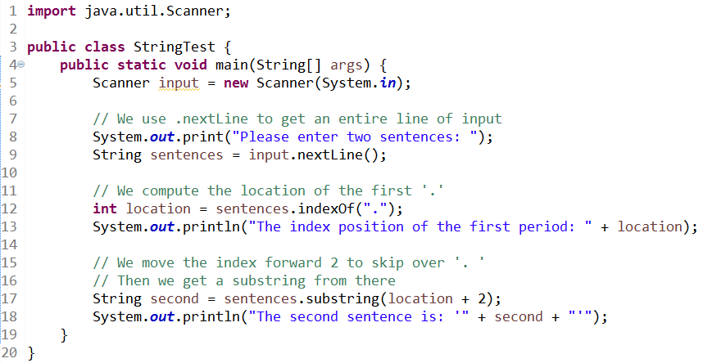

String Slicing
We can take the index of substrings and use that to slice pieces of a String:

Slide 13
String Slicing
If you give two numbers to .substring(), it will define a slice based on a starting and an ending point:
String test = original.substring(3, 7);
The new string now contains the characters from index 3 to index 6 of the original string. Remember, the last number is NOT included!

Slide 14
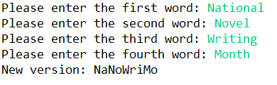
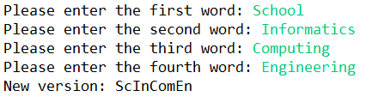
Shortener (Group Work)
National Novel Writing Month is a project affectionately known to participants as “NaNoWriMo”. Write a program that uses String slicing to convert any four words into a similar “shorter” version using a 2-2-3-2 pattern:

Slide 15
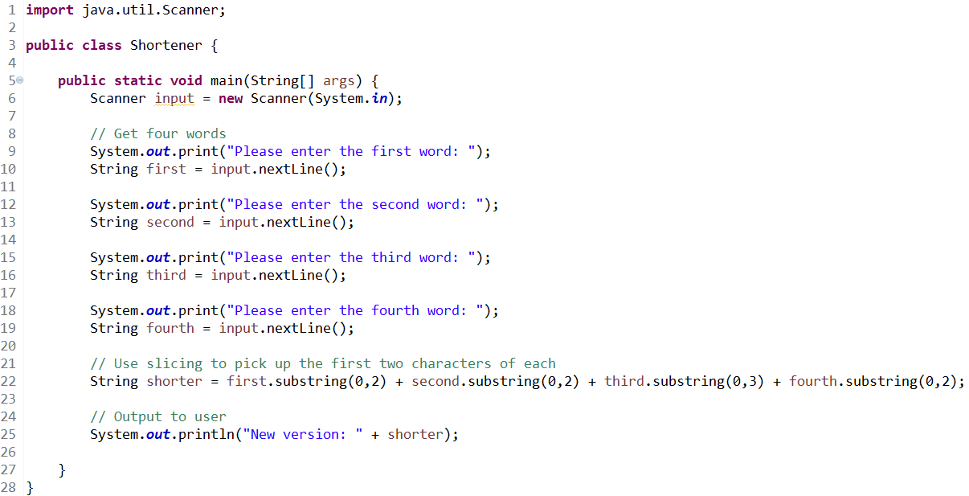
Shortener (Solution)

Slide 16

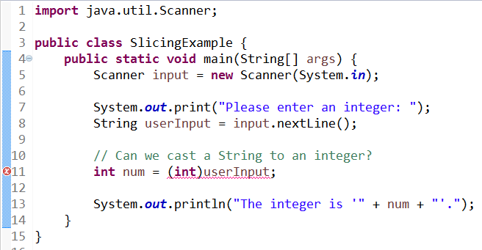

String -> Integer
Caution – You can’t just cast a String to a integer!

Slide 17
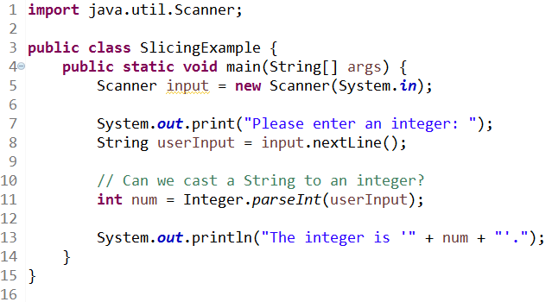

String -> Integer
Instead, we have Integer.parseInt() :

Slide 18
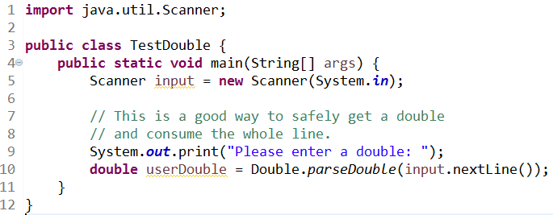
String -> Double
This also gives us an alternate way to solve the “.nextInt() and .nextDouble() don’t consume the newline” problem.

Slide 19
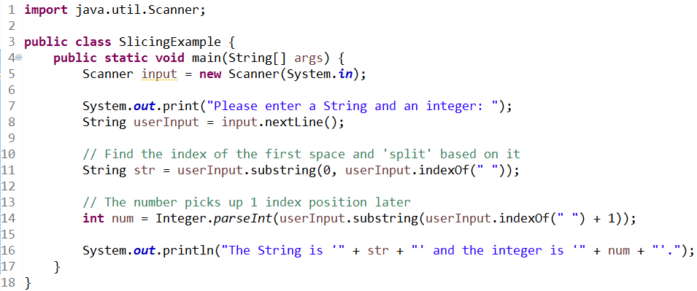

String Slicing
Using substring slicing, we can separate two inputs on the same line:

Slide 20
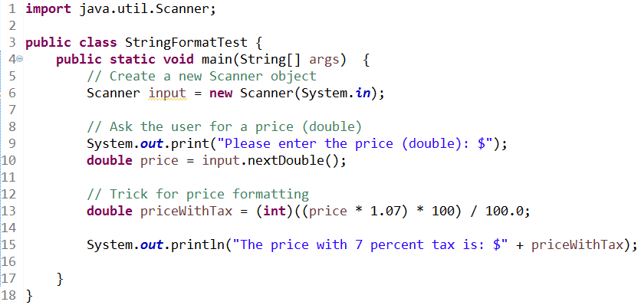


String Formatting
Our previous trick to display dollar amounts leaves something to be desired:
It’s time we learned real string formatting!
Good:
Bad:

Slide 21
String Formatting
We’ll use the .printf() method in combination with a template string. (You’ve seen this before in Python as .format() )
Precision
Conversion Code | Output
%b | Boolean
%c | char
%d | Integer
%f | Float
%s | String
%4.2f
Min field width
Conversion code

Slide 22
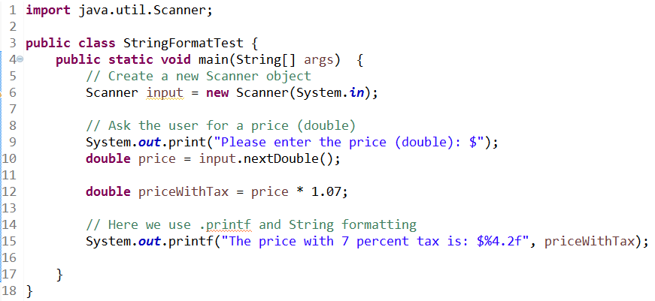

.printf()
We use the .printf() method in combination with a template string:

Slide 23
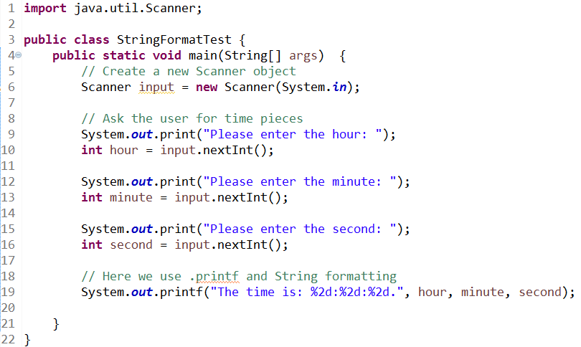

.printf()
We can have multiple placeholders in a line:

Slide 24
Money (Group Work)
You go to the bank and request an amount of money. The bank teller will give you your money (as efficiently as possible), using the following units: Bills - $100, $20, $10, $5, $1 Coins - $.25, $.10, $.05, $.01
Write a program that can calculate the most efficient breakdown of any amount of money into these units. Use .printf for output.
HINT: Modulus is very useful here!

Slide 25
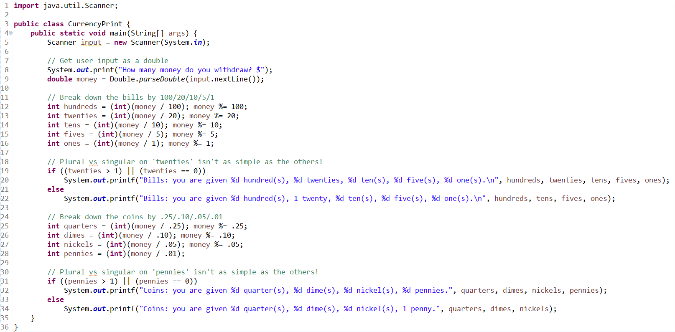
Money (Solution)

Slide 26
Questions?

